Slide 1

Developing your skills and leadership in prescribing
Charlie Spencer
Lead Advanced Clinical Practitioner
Cardiology, Warwick Hospital (SWFT)
@cardiacchazz
https://www.facebook.com/groups/cardiologynurseforum

Slide 2
Sub Topics
What do non-medical prescribers need to support their role.
Developing your skills as a non-medical prescriber.
Prescribers scope of practice.
Integrating prescribing practice into service development.
How to make a difference as a non-medical prescriber.

Slide 3
Background
There has been a rapid in expansion in non-medical prescribing.
In 2015 it is estimated there were 53,572 registered nurse and midwife, 3845 pharmacist and 689 allied healthcare professional non-medical prescribers in the UK (i5Health, 2015).
However data on those who were actively prescribe is limited:
In 2010 survey data suggested 14% of nurse independent prescribers and 29% of pharmacist independent prescribers were not actively prescribing! (Latter et al. 2010).

Slide 4
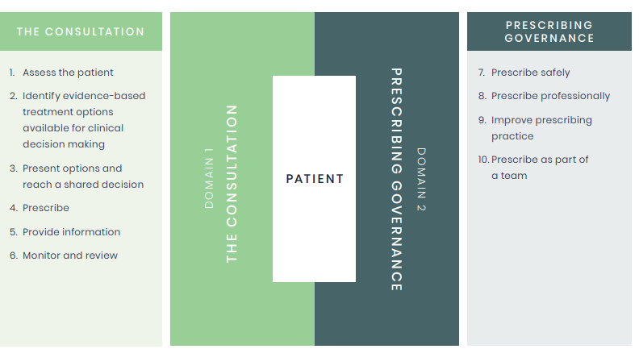
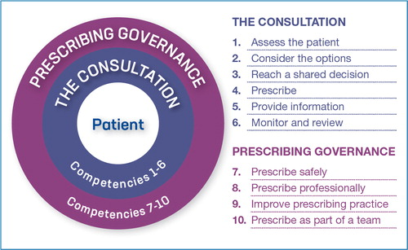
RPS (2021) Competency Framework for all Prescribers

Slide 5
What do trained non-medical prescribers need to flourish?
Confidence to prescribe:
  Knowledge and skills appropriate to the setting.
  A clear scope of prescribing practice.
  Trust in employer and medical support of prescribing.
The trust of patients:
  Acceptance of and trust in NMP role.
  Time and resources to discuss an educate patients.
Opportunities to develop:
  Feedback on practice and opportunities to improve.
  Involvement in service development

Slide 6
How can these needs be supported in practice?
An agreed scope of prescribing practice within the individual role.
Inclusion of prescribing practice in professional portfolio and annual appraisal
Appropriate supervision and mentorship.
Feedback on prescribing practice.
Peer support e.g. forums and networks.
Access to further training and education.
Involvement in local audit and service improvement relevant to prescribing.

Slide 7
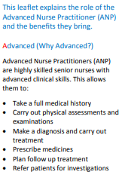
How can these needs be supported in practice? Cont.
NMP representation in prescribing governance and at senior levels within organisation.
Access to, and involvement in developing resources for patient education and shared decision making relating to medicines.
Sufficient time in job plan for development and governance activities.
Explanation of NMP roles and responsibilities available to patients.

Slide 8
Trust and regional level
Governance mechanisms
Designated lead for non-medical prescribing. Medicines safety officer.
NMP inclusion in medicine safety committee
Regional medicine safety groups.
Governance committee, incident reporting
Local Formulary agreements, Protocols, shared care agreements, SOPs and patient pathways.

Slide 9
National and international Prescribing Governance
RPS standards for prescribing. Regulatory bodies e.g. NMC, CQC, NHS improvement, HSE
MHRA , medicine safety alerts including prescribing errors.
NHS initiatives e.g. The Medicines Safety Improvement Programme, long term plan, relevant CQUINs
WHO 3rd Global Patient Safety Challenge - ‘Medication Without Harm’.
Charity and independent organisations e.g. BHF.

Slide 10
Developing your skills as a non-medical prescriber.
Take responsibility for your professional development:
  Take the lead on your development plan.
  Take advantage of a wide range of learning opportunities.
  Record case based discussions and reflection on practice in portfolio.
  Audit practice and seek feedback from various sources.
Identify opportunities to improve prescribing practice:
  Gaps in care and avoidable delays.
  Improving medication adherence.
  Identify and report prescribing errors
Engage in Networking e.g. NMP or other cross specialty forums, conferences, professional groups.

Slide 11
The scope of practice for the non-medical prescriber.
Interdependent with wider role and individual scope of practice e.g. ability to order or interpret tests.
Must be in line with trust policies, law, governing body guidance and individual competence.
May include departmental or organisational NMP formulary restrictions but these may be unhelpful as competence is dynamic.
May include guidance on when to refer on e.g. high risk or unlicensed drugs, complex patients or diseases.
Can be important evidence for complaints or fitness to practice hearings.

Slide 12
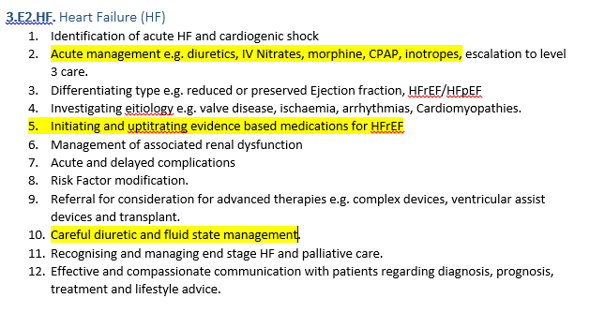
Example of Cardiology ACP competencies relating to scope

Slide 13
Integrating prescribing practice into service development
Evaluating where prescribing could improve care
  A wealth (sometimes overwhelming quantity) of evidence for many medications.
  Evidence based national targets e.g. hypertension and lipid management.
  Auditing services for gaps in prescribing e.g. lipid management in cardiac rehab. Chronic condiditon reviews in primary care.
  Where NMPs are well placed to optimise medication regimes and adherence.

Slide 14
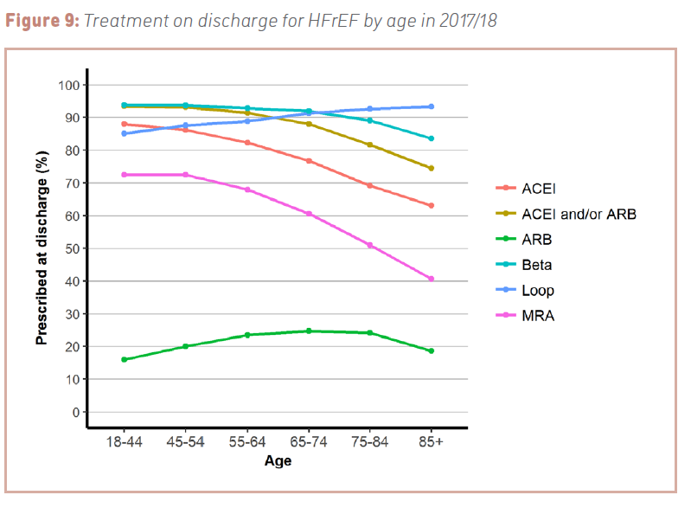
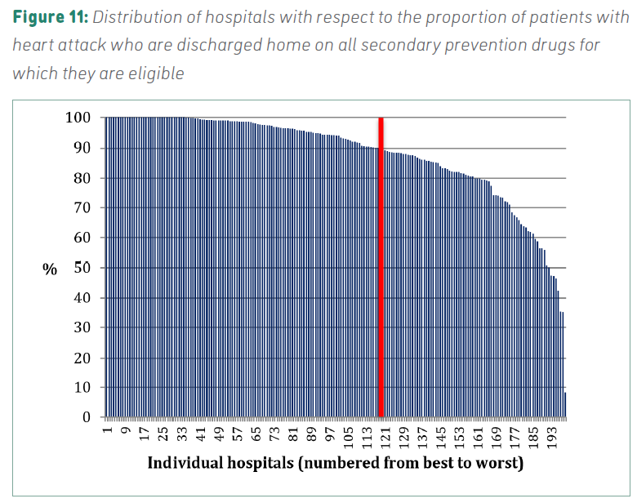
National audits provide hospital level data on presribing compliance
MINAP
National Heart Failure audit

Slide 15
NHS long term plan CV priorities
Earlier diagnosis and treatment of high risk CV conditions including HF, AF, hypertension and familial hypercholesterolaemia.
  Improving links between primary and secondary care.
Increase evidence based treatment for high risk CV conditions particularly using nurses in primary care to case find and treat. e.g. anticoagulation for AF.
  Opportunities for community based clinics.

Slide 16
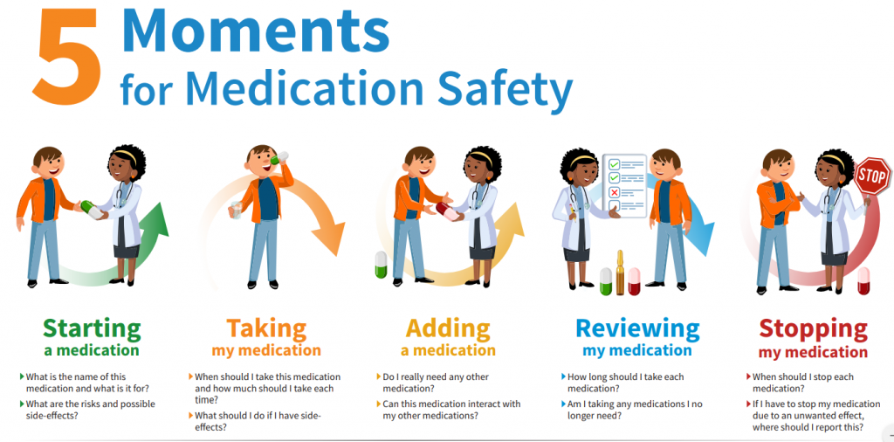
Which ‘moments’ does your service cover?
If your service does not cover all these moments consideration should be given to where they occur e.g. GP or specialist.

Slide 17
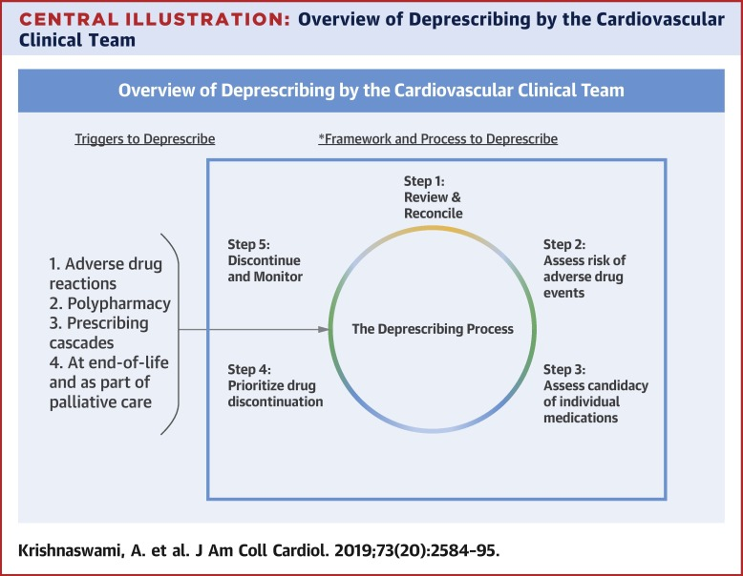
Deprescribing

Slide 18
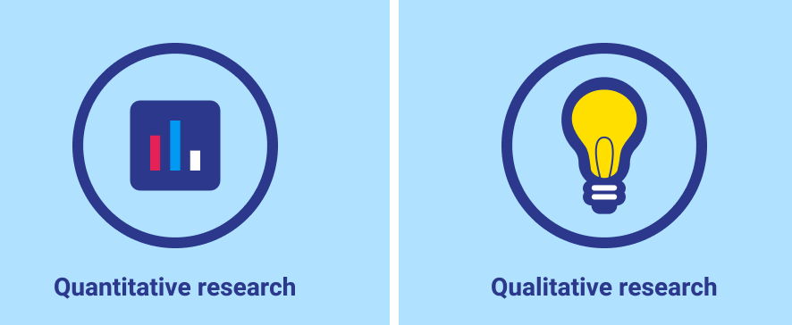
Local audit and service evaluation
Audit prescribing practice using data from a range of sources e.g. EPMA, procedures, case loads, clinic, diagnostic codes to identify opportunities e.g:
  Measureable targets e.g. BP or HbA1C.
  Adherence to guidelines e.g. secondary prevention, Heart Failure, AF anticoag.
  Prescribing delays and patient outcomes e.g. avoid delegating prescribing to GP, or NMP versus consultant clinic wait times.
Methods such as structured interviews and surveys with appropriate thematic analysis e.g:
  Patient perception and understand of medications.
  Exploring reasons for non-adherence and disengagement with services.
  Exploring clinician bias and motivation for prescribing decisions e.g. withholding anticoagulation in AF, de-prescribing statins in IHD.

Slide 19
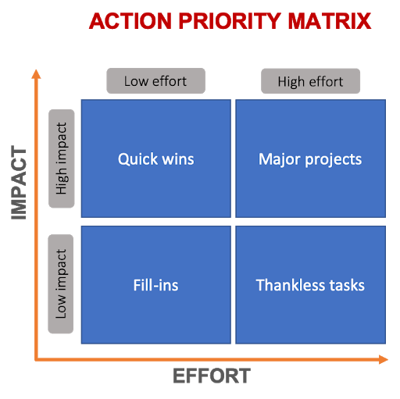
How to prioritise prescribing service improvement
‘Quick wins’ are a good start e.g:
  Electronic prescribing ‘sets’.
  Patient information leaflets.
  Tools to aid NMPs in achieving optimal medical therapy (OMT).
‘Fill ins’ can also provide evidence
  Education to improve prescribing.
  Systems to identify medication issues to prescribers from current non-prescribers.
‘Major projects’ involve significant planning and resources:
  Setting up clinics.
  Local guidelines, protocols
  Introducing new NMP services.
  Easier if aligned with national priorities and trust values.
Above all the needs and priorities of your patients!

Slide 20
Developing a new non-medical prescribing service.
Identify purpose and goals of new service.
Build a business case including staffing and resources to cover:
  Non-clinical time e.g. audit, development etc.
  Appropriate leadership and supervision.
  Education and training budgets.
  Framework for clinical governance and scope of practice.
Resist pressure to deliver inadequately resourced services. Trials may be an exception.
Link with relevant local, regional and national networks, organisations and committees.

Slide 21
SWFT Cardiology ACP team Structure
1 trainee and 3 full ACPs with nominal lead.
Ultimately responsible to clinical director, general manager and consultant nurse (ACP and NMP lead).
20% protected non-clinical time for audit & development.
All prescribers and nurses by background.
Prescribing for general cardiology and general medical patients essential for role in clinic, outreach and ward.
Unlicensed medicines not commenced unless covered by protocol, SOP or on behalf of consultant.
All have a consultant Cardiologist mentor as well as support from ACP team lead.
Have led on local guidelines for AF, DCCV and ACS.

Slide 22
How can you make a difference as a non-medical prescriber?
Every contact matters! NMPs are often well placed to identify and manage risk factors and engage patients in optimising their health.
Time to treatment – take opportunities to start important medications early.
Combine your unique skills and experience as a nurse or AHP with your prescribing practice.
Ask about side effects and adherence – negotiate sustainable care plans, switch and deprescribe appropriately or refer on.

Slide 23
Making a difference examples
Patient attending for routine echocardiogram found to have life threatening cardiac arrhythmia at 240bpm.
  I attended as the Cardiology outreach ACP
  Patient stabilised with IV Metoprolol
  transferred directly to CCU before completing a medical clerking and medication history.
Ward patient switched from warfarin to DOAC.
  Identified DOAC started too early as last INR 2.6.
  Pt assessed, DOAC held, INR ordered, consultant informed, incident reported.

Slide 24
Making a difference examples
Clinically stable patient attended A&E with a new community diagnosis of severe heart failure.
  Seen clinically and examined.
  Relevant blood tests taken.
  Low dose Entresto (Sacubitril/Valsartan) and Bisoprolol prescribed.
  Admission avoided, early ambulatory care appointment with Cardiologist arranged.
Moving contrast echos to my list – previously echocardiographer with Cardiologist cannulating and administering contrast.

Slide 25
Summary
NMPs need appropriate job plans, scope of practice and support to maintain and develop prescribing competence.
This is best achieved when prescribing is a well defined and integrated part of the job role and services provided.
NMPs are often well placed to identify gaps in care and opportunities to improve care and medication management for patients.
Patient focussed NMP services can transform care and provide great job satisfaction.

Slide 26
Questions and References
SCALLY, G. & DONALDSON, L. J. 1998. Clinical governance and the drive for quality improvement in the new NHS in England. British Medical Journal, 317, 61-65.
RPS. 2016. A Competency Framework for all Prescribers. Royal Pharmaceutical Society.
KRISHNASWAMI, A., STEINMAN, M. A., GOYAL, P., ZULLO, et al. 2019. Deprescribing in Older Adults With Cardiovascular Disease. J Am Coll Cardiol, 73, 2584-2595.
OIKONOMOU, E., CARTHEY, J., MACRAE, C. & VINCENT, C. 2019. Patient safety regulation in the NHS: mapping the regulatory landscape of healthcare. BMJ Open, 9, e028663.
I5HEALTH 2015. Non-Medical Prescribing (NMP) An Economic Evaluation.
LATTER, S., BLENKINSOPP A., SMITH A., CHAPMAN S., TINELLI M., GERRARD K., et al. (2010) Evaluation of nurse and pharmacist independent prescribing. London: Department of Health.

